Slide 1
Developing Effective Learners
CPD Pack
Issue 3 - Impact - Developing Effective Learners

Slide 2
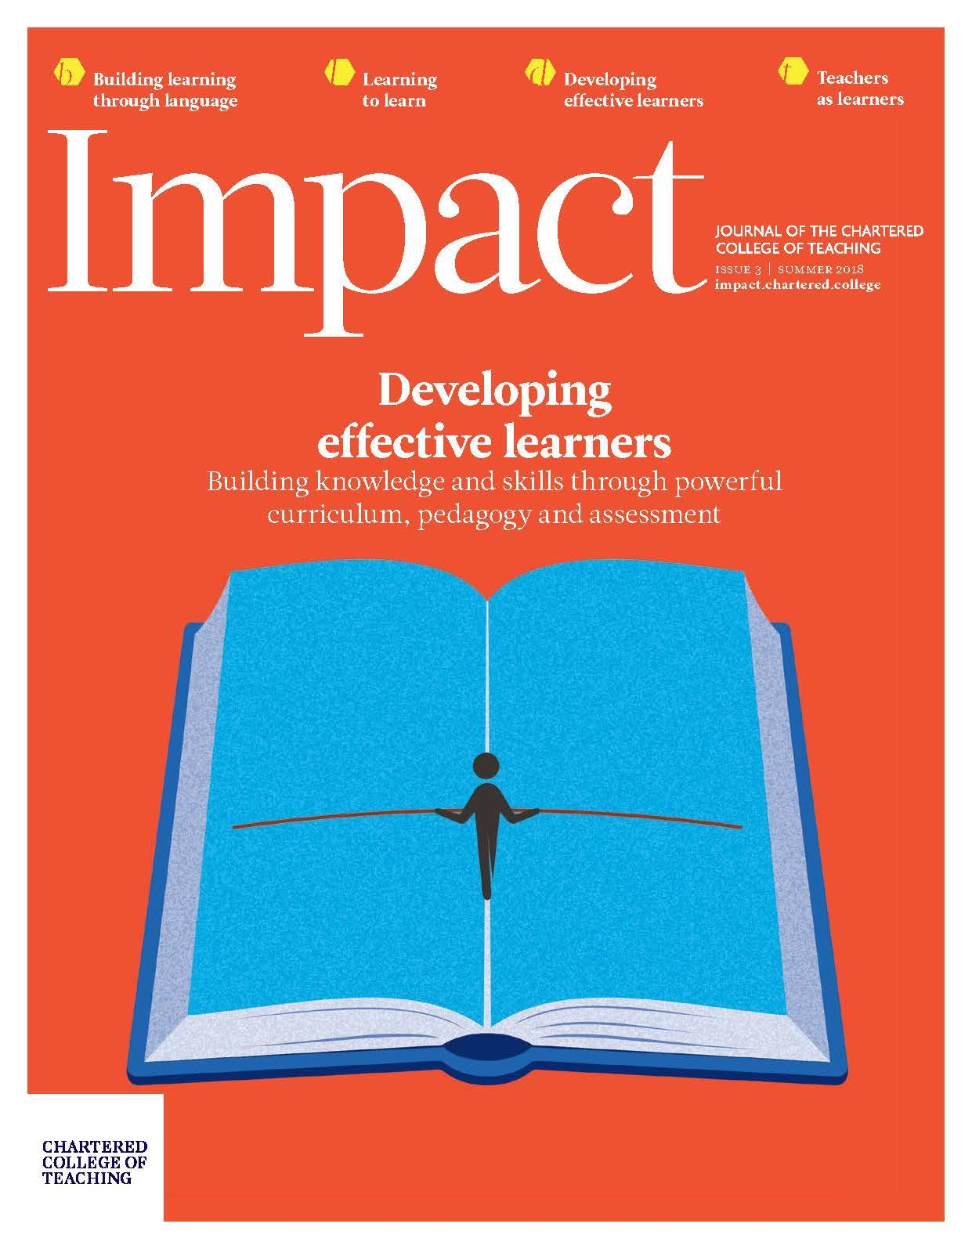
This issue of Impact is edited by Jonathan Sharples and shares insights into building knowledge and skills through powerful curriculum, pedagogy, and assessment.
The materials that follow are related to the articles:
‘Effective learning: Beyond the traditional/progressive Punch and Judy show’, written by Guy Claxton
‘Making sense of metacognition’, by Alex Quigley and Eleanor Stringer.
These materials will help you to discuss and explore these articles, considering what effective learning looks like to you and what you can do to enable it in your classroom.

Slide 3
Session aims
Consider what ‘Effective learning’ is
Explore some of the research and theory that encompasses ‘Effective learning’
Consider implications for teaching practice.

Slide 4
Think of a pupil who you consider to be an effective learner.
What does their learning look like? What sorts of things do they do and say?
List the traits, behaviours and actions of this pupil.
Now share your list with a colleague. Compare your lists and consider what enables this pupil to be this way?
What do you do as a teacher to encourage the listed traits and behaviours in all pupils?

Slide 5
Learning to Learn
Read the Impact article ‘Effective learning: Beyond the traditional/progressive Punch and Judy show’, written by Guy Claxton.
Discuss in a pair or small group:
What does the author consider to be ‘effective learning’?
What are the three ‘layers’ of learning described in the article? What are your thoughts on these layers?
Have you heard of any of the associated theories and research encompassed within the ‘Learning Power Approach’?
Is there anything in the article that you agree or disagree with in particular?

Slide 6
Layers of Learning:
Knowledge
Skills
Attitudes and mindsets
What are your thoughts on the relative importance of each layer? How much time and attention is given to developing each in your classroom?

Slide 7
Consider the aspects of pedagogy below. Which encourage the development of knowledge? Which lead to skill development? And which cultivate good attitudes and mindsets towards learning?
Opportunities for practice and consolidation
Clear explanations of concepts
Asking good diagnostic questions
Collaborative projects
Giving quality feedback
Activities that allow expertise to be stretched
Encouraging pupils to make decisions about their learning
Checking for understanding
Modelling struggle and challenge
Classroom layout

Slide 8
Research
In pairs or groups of three, take one of the areas below to research.
Studio Thinking (Hetland et al., 2007)
Cultures of Thinking (Ritchhart, 2015)
Expeditionary Learning Schools (now called EL Education) (see Berger, Woodfin and Vilen, 2016)
Habits of Mind (Costa and Kallick, 2009)
Project for the Enhancement of Effective Learning (PEEL) (Baird and Northfield, 1992)
Cognitive Acceleration through Science and Mathematics Education (CASE and CAME) (Shayer and Adey, 2002)
Building Learning Power (Claxton, 2002; Claxton et al, 2011)
Learning without Limits (Hart et al., 2004)
Learner Profile (Peterson, 1972).
After reading and discussing your area, feedback to the rest of the group:
What are the key ideas behind the approach?
What research supports the approach?
What are the implications for teaching and learning?

Slide 9
Research
After hearing about various approaches from the list, consider:
Which interests you the most, and why?
What do these approaches have in common?
How do they relate to what Claxton calls ‘The Learning Power Approach’?

Slide 10
Learning to Learn
Read the Impact article ‘Making sense of metacognition’, written by Alex Quigley and Eleanor Stringer.
Discuss in a pair or small group:
What is metacognition?
What is the relationship between metacognition and subject knowledge?
How does this article relate to the previous article by Guy Claxton?
Is there anything in the article that you particularly agree or disagree with?

Slide 11
Is there anything that you already do in your classroom to help students develop their metacognitive skills?
What works well?
What else would help students to develop:
Knowledge of themselves as a learner;
Knowledge of appropriate strategies;
Knowledge of the task?
What have you seen/ heard others doing to encourage metacognition?

Slide 12
Reflection
Is there anything you would like to research further?
Are you in agreement with the articles read today?
Is the research base robust enough?
Is there anything you would like to change, try or adapt in your classroom following today’s session?

Slide 13
Further reading
Online reading and resources:
Cambridge Assessment (no date) Getting started with metacognition. Available at: https://cambridge-community.org.uk/professional-development/gswmeta/index.html
Building Learning Power (no date) Creating metacognitive classroom cultures. Available at: https://www.buildinglearningpower.com/2018/05/creating-metacognitive-classroom-cultures/?inf_contact_key=c39989dfce2e314ba242202e8d52c9a5d5d064261767a9c66bb0ba617b081fa2
Education Endowment Foundation (2018) Metacognition and self-regulation. Available at:
https://educationendowmentfoundation.org.uk/evidence-summaries/teaching-learning-toolkit/meta-cognition-and-self-regulation/
Building Learning Power (no date) Building Learning Power. Available at:
https://www.buildinglearningpower.com/
Carlzon, B (2018) Learning Power Kids. Available at: http://learningpowerkids.com/learning-power-approach/
Green, J (2015) Can we ditch ‘Building Learning Power’ now? Available at:
https://julietgreen.wordpress.com/2015/03/07/can-we-ditch-building-learning-power-now/

Slide 14
Books and Research papers
(unless otherwise stated, all papers are available free for members of the
Chartered College of Teaching at https://members.chartered.college/ebsco)
Baird JR and Northfield JR (1992) Learning from the PEEL Experience.
Melbourne: Monash University Press.
Christodoulou D (2014) Seven Myths about Education. London: Routledge.
Claxton GL (2002) Building Learning Power. Bristol: TLO Ltd.
Clad thinking about soft skills. Educational Leadership, 73(6), 60 -64. Costa A and Kallick B (2009) Habits of Mind across the Curriculum: Practical and Creative Strategies for Teachers. Alexandria VA: ASCD.
Hart S, Dixon A, Drummond MJ and McIntyre D (2004) Learning without Limits . Maidenhead: Open University Press.
Hetland L, Winner E, Veenema S and Sheridan KM (2007) Studio Thinking: The Real Benefits of Visual Arts Education. New York: Teachers College Press.
Resnick L (1999) Making America smarter. Education Week Century Series 18(40), 38–40.
Ritchhart R (2015) Creating Cultures of Thinking. San Francisco: Jossey-Bass.

