Slide 1
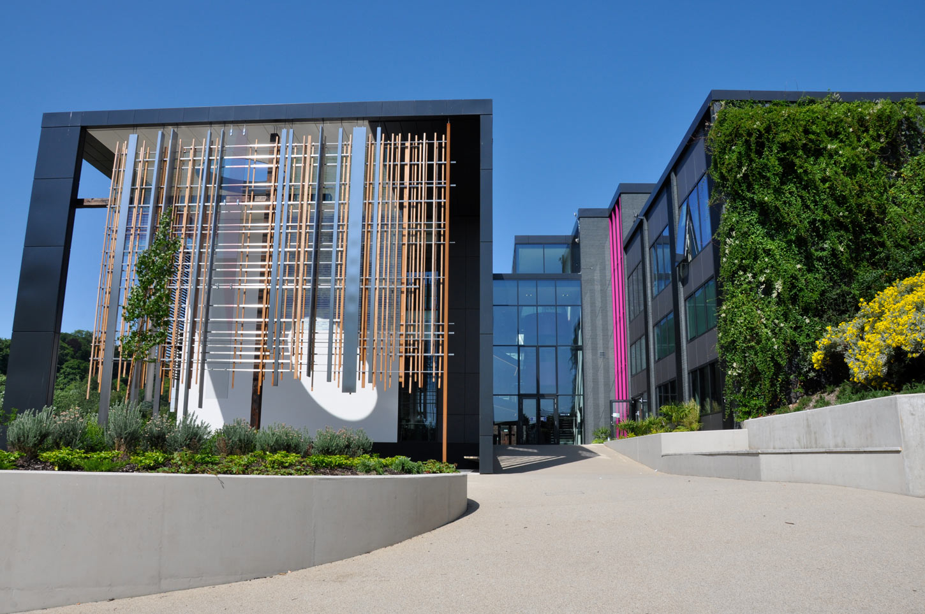
Children seeking sanctuary and the welcoming teacher:
learning a new language in a new place.
Dr. Julie Wharton
University of Winchester

Slide 2
Aims
To reflect on best practice to teach English to children and young people who are refugees and asylum seekers.
To consider practical examples of how you might ensure children and young people are supported to learn a new language on arrival in educational settings.

Slide 3
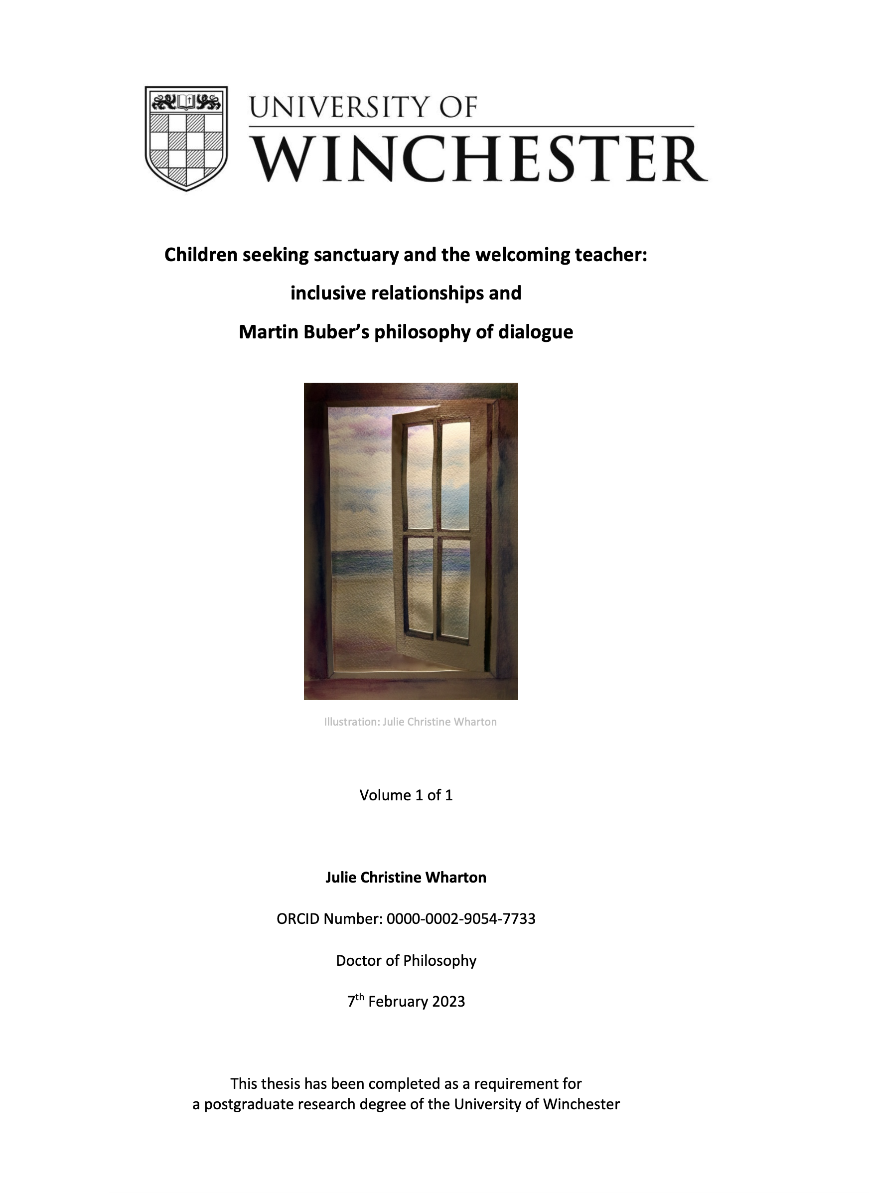
Research
Interviews with seven primary teachers in Schools of Sanctuary were conducted through a two-part process. Part one was an initial dialogic encounter with an educator, which took place using Teams. This encounter was then transcribed as the preparation for Part 2. This transcription acted as a focus for part two – the second dialogic encounter. In this second encounter, themes that emerged from the first interview were explored, and a second transcription was created.

Slide 4
Martin Buber – I and Thou
Gardener Educator
Sculptor Educator

Slide 5
Key points emerging from the dialogic encounters in my research address:
ways to support the language needs,
emotional needs, and
the need to belong experienced by children seeking sanctuary.

Slide 6
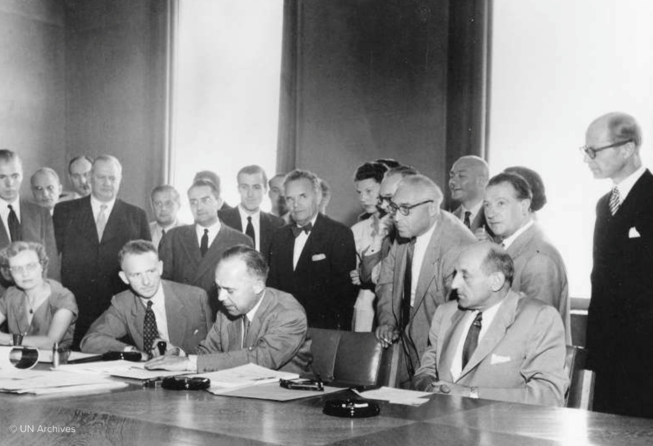
The United Nations Refugee Convention 1951
The 1951 Refugee Convention and its 1967 Protocol are the key legal documents that form the basis of the work of the UN Refugee Agency.
(UN Refugee Agency, 2022)

Slide 7
Article 1 definition of the term “refugee” A. For the purposes of the present Convention, the term “refugee” shall apply to any person who…
…owing to well-founded fear of being persecuted for reasons of race, religion, nationality, membership of a particular social group or political opinion, is outside the country of his [sic] nationality and is unable or, owing to such fear, is unwilling to avail himself of the protection of that country; or who, not having a nationality and being outside the country of his former habitual residence as a result of such events, is unable or, owing to such fear, is unwilling to return to it.
(UNHCR, 2010:14)

Slide 8
Who is an asylum seeker in the UK?
In the UK, a person becomes a refugee when government agrees that an individual who has applied for asylum meets the definition in the Refugee Convention they will ‘recognise’ that person as a refugee and issue them with refugee status documentation. Usually refugees in the UK are given five years’ leave to remain as a refugee. They must then must apply for further leave, although their status as a refugee is not limited to five years.
(Refugee Council, 2022:[online])

Slide 9
The Syrian Vulnerable Persons Resettlement Scheme (VPRS) involved the UK working closely with the UN High Commissioner for Refugees (UNHCR) to identify those most at risk and bring them to the UK.
Launched in January 2014 and this scheme supported people requiring urgent medical treatment, people who had survived violence and torture, and women and children who were considered at risk. (Home Office, 2017)
Resettlement schemes
What are these?

Slide 10
The UK formally opened the Afghan Citizens Resettlement Scheme (ACRS) on 6 January 2022.
The scheme prioritises:
those who have assisted the UK efforts in Afghanistan and stood up for values such as democracy, women’s rights, freedom of speech, and rule of law
vulnerable people, including women and girls at risk, and members of minority groups at risk (including ethnic and religious minorities and LGBT+)
(Gov.UK,2022:[online])
Resettlement schemes
What are these?

Slide 11
The UK has put 3 different Ukraine Schemes in place to support those who wish to either come to or remain in the UK:
Ukraine Family Scheme - if you have family who are settled in the UK, you may be able to apply to the Ukraine Family Scheme
Homes for Ukraine - if you want to be sponsored by a UK household for 6 months, you may be able to apply to the Homes for Ukraine scheme
Ukraine Extension Scheme - you can apply for this scheme if one of the following is true:
you held permission to be in the UK on or between 18 March 2022 and 16 May 2023 – the permission does not need to cover the whole period
you previously held permission to be in the UK and that permission expired on or after 1 January 2022
This route does not require a UK based sponsor. (Gov.UK, 2023:[online])

Slide 12
Causes of forced migration
Violence
Conflicts
Environmental and/or
Economic reasons (Yousaf, 2018)

Slide 13
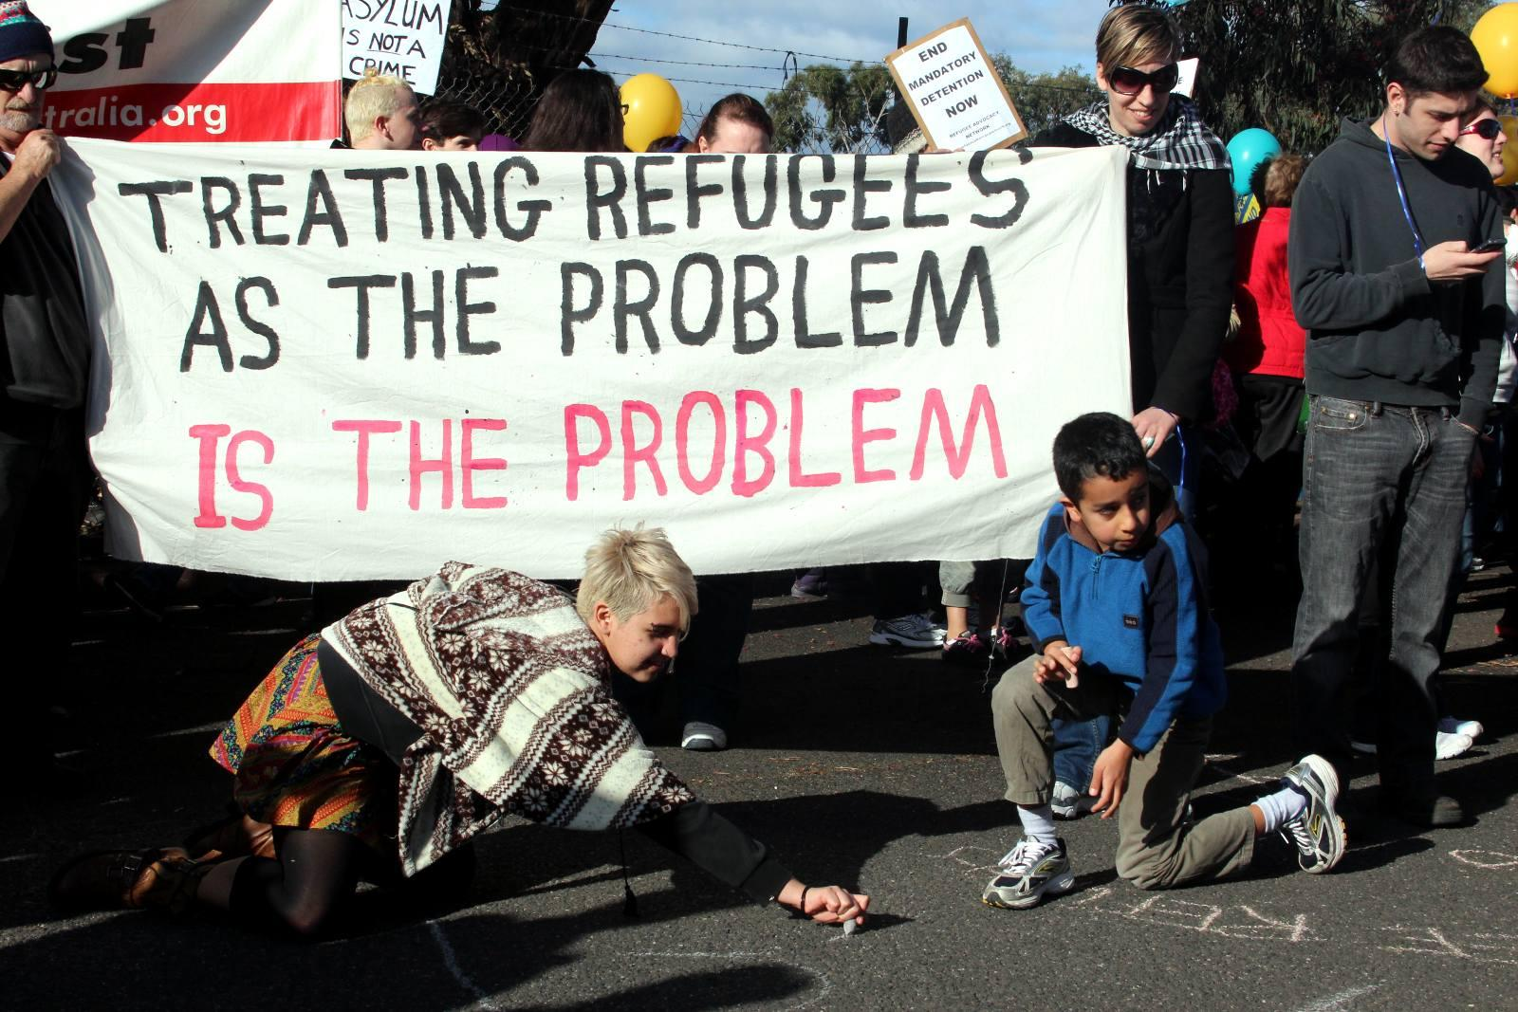
As Pumphrey (2010:6) states, ‘subjective judgements concerning the labelling and categorisation of individuals and groups represent an ever-present potential educational danger: the oversimplification of complex concerns.’
Notes:
With an increasing number of children and young people being included in schools in England, schools are often in the position of having to identify a need and categorise children and young people according to an essentialist model: ‘refugee’ or ‘non-refugee’. The label tells us little of the person or the environment in which they are situated.

Slide 14
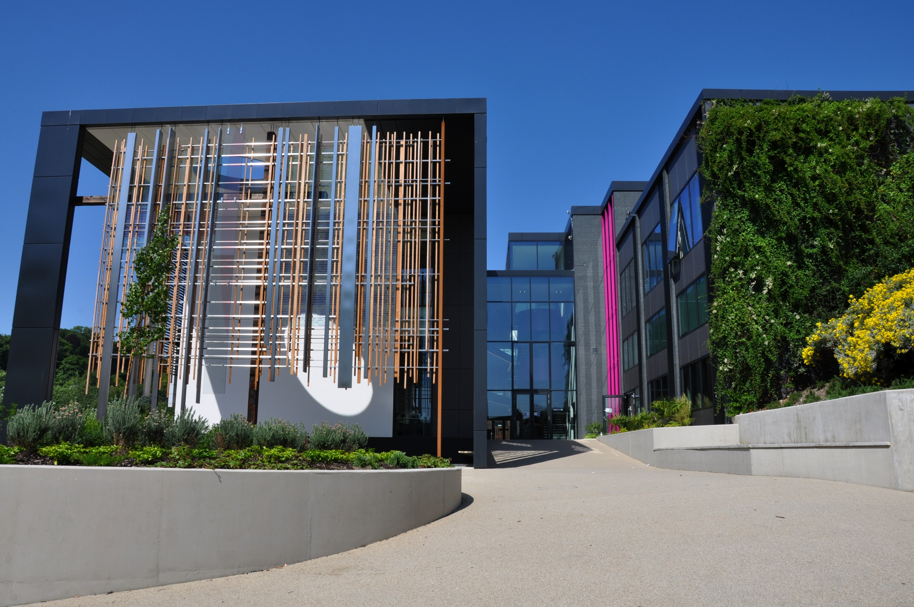
At the University of Winchester ‘We use the term ‘sanctuary’ rather than ‘asylum’ to avoid the negative connotations of phrases such as ‘asylum-seekers’’ (University of Winchester, 2016:1).
Notes:
Working alongside Article 26, a project to enable people who have sought asylum, The University of Winchester supports a small number of people seeking sanctuary to access higher education by offering tuition fee support, a bursary of £2,000 and personal support.

Slide 15
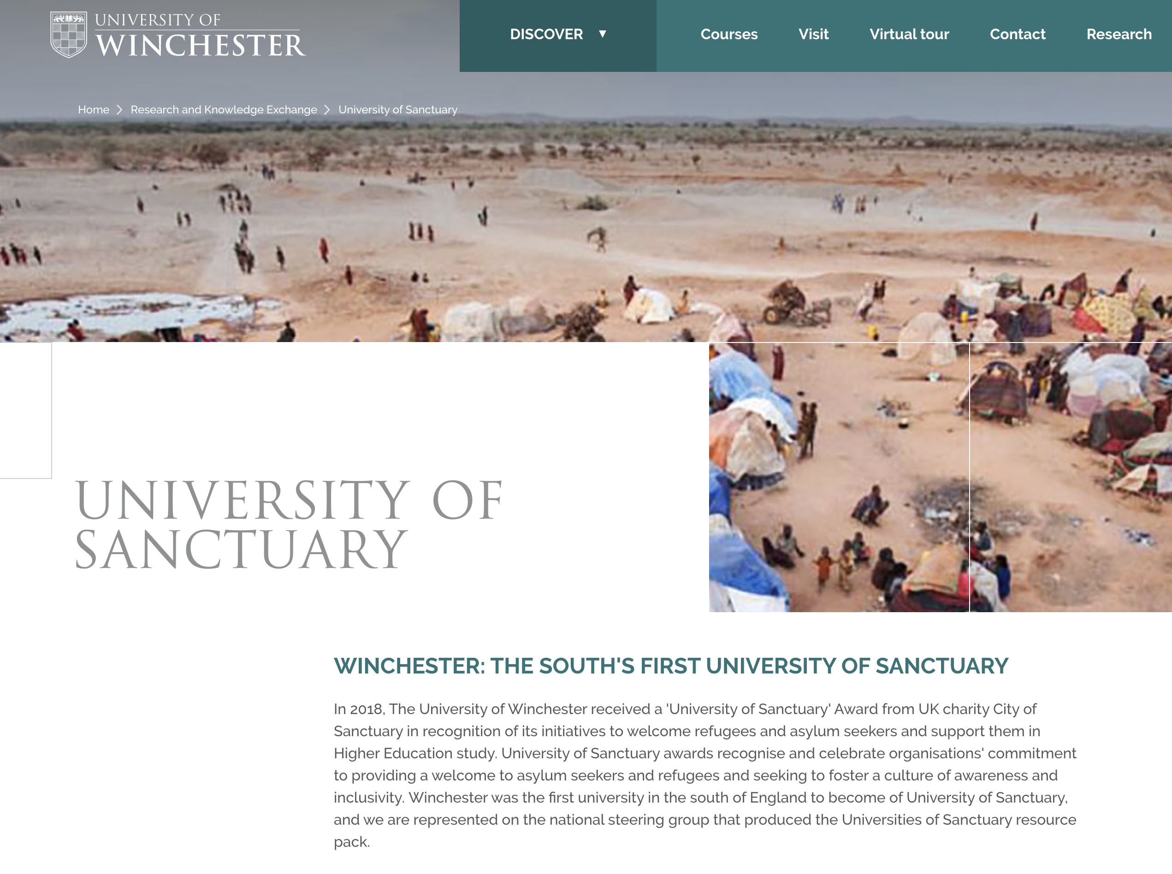
University of Sanctuary
https://winchester.ac.uk/research/university-of-sanctuary/
https://winchester.ac.uk/research/university-of-sanctuary/

Slide 16
City of Sanctuary
https://cityofsanctuary.org/

Slide 17
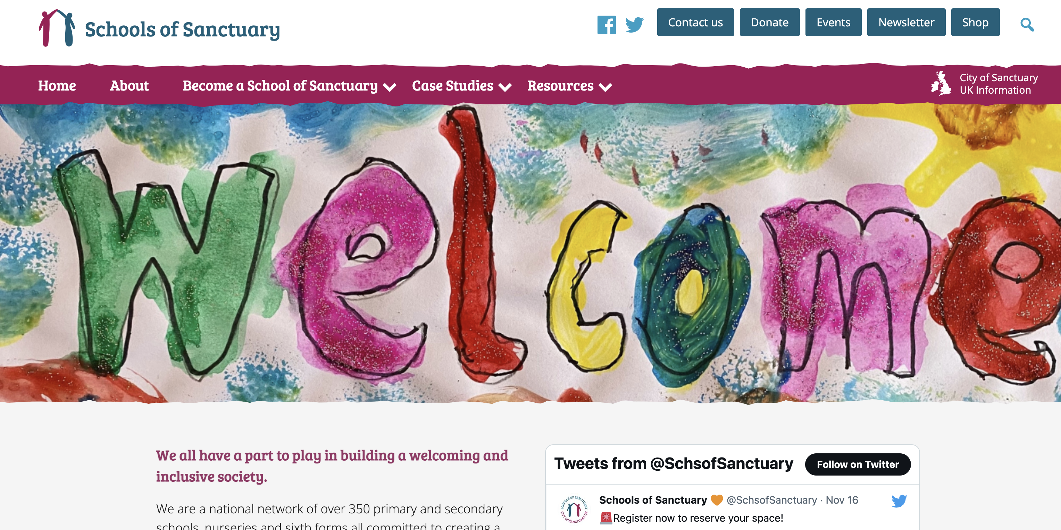
https://schools.cityofsanctuary.org/
What is a school of sanctuary?
Notes:
‘A School of Sanctuary is a school that is committed to being a safe and welcoming place for all, especially those seeking sanctuary. This could be people whose lives were in danger in their own country, who have troubles at home or are just looking for a space of safety. A School of Sanctuary is a school that helps its students, staff and wider community understand what it means to be seeking sanctuary and to extend a welcome to everyone as equal, valued members of the school community. It is a school that is proud to be a place of safety and inclusion for all. The programme began in Yorkshire, England, but there are now Schools of Sanctuary in Wales and Ireland and the resources can be adapted for a variety of school demographics and education systems.’

Slide 18
What is a School of Sanctuary?
A place that fosters a culture of welcome and safety for people seeking sanctuary, including asylum seeking and refugee families.
Educates the whole school community about the human right to sanctuary and identifies practical means for schools to demonstrate that commitment.
Builds empathy and intercultural awareness through promoting the voices and contributions of people seeking sanctuary, encouraging an understanding of the experiences of displaced people and helping to combat stereotypes.

Slide 19
The programme began in Yorkshire, England, and there are now Schools of Sanctuary in Wales and Ireland as well as many English cities and towns, and the resources can be adapted for a variety of school demographics and education systems.
There are three processes that schools need to demonstrate that they do:
Learn (these involved exploring what it might mean to be seeking sanctuary)
Embed (schools should demonstrate that they are inclusive and provide welcome and safety in school and in the community.
Share (schools have to commit to share the work that they have undertaken in this area)

Slide 20
What was comforting, though, when you kind of work through the process of becoming a School of Sanctuary, there are kind of three things you have to do. And because of the nature of schools and, you know, their inclusive nature anyway, lots of things were already covered, which was good to know, but the specific refugee elements weren’t and that really opened my eyes to thinking, OK, yeah, we don’t do enough for this. I don’t think anybody does because it’s not really part of our training. It’s not, you know, part of the package for teachers.
Lucy (pseudonym), Deputy Head and School of Sanctuary lead

Slide 21
Why is inclusion important?
Education has come to be considered as the ‘fourth aspect’ of an emergency response alongside ‘food, shelter and health care’ (Norwegian Refugee Council, 1999:4e), and, if society is to honour the significance of education, educators need to be aware of the importance of being welcoming whilst addressing the learning, social and emotional needs of the newly arrived students in their classrooms.

Slide 22
Rutter (2003:99) proposes that inclusion in school is a very significant part of the experience of a child who has been forced to migrate: ‘attending school is in itself therapeutic and a normalising experience in a life that may have been far from normal’.

Slide 23
Welcome
Consider creating a welcome pack in a variety of languages.
Use this induction period to:
get to know each child/young person;
provide some basic ‘survival’ English phrases;
undertake an assessment of their language abilities as well as ascertaining the areas of the curriculum that they are able to engage with and
support peer buddies to give tours of the setting and an overview of what to expect at each time of the day – the question of ‘language brokering’ (Stewart, 2023)

Slide 24
So they just stand either side of the line and kind of play, follow the leader without crossing the lines.
Rachael (pseudonym), Year 1 teacher in a School of Sanctuary

Slide 25
Cultural differences
Your setting may be a very different environment for newly arrived children and young people. Some learners may not have had a formal education for quite a while. Things to consider:
uniform expectations
food
mixed-gender environments
different attitudes (e.g. disability)

Slide 26
Language learning
Approaches to this can be divided into an individualistic approach designed to address language deficits and a more collectivist approach that celebrates diversity and enables inclusion. When children are withdrawn for language teaching, the shift from inclusion in mainstream lessons may lead to them being taught in specialist provision. A completely segregated approach has been deemed to be educationally and socially unacceptable (Swann, 1985).

Slide 27
Costley (2014:284) suggests that with the English Education Act 1988 and the introduction of The National Curriculum, ‘learning English as a mother tongue and as an additional language have, as a consequence, been conflated’ so that children are not given the benefit the discrete skills of teaching English as an additional language, thus arguing for separate intervention groups.

Slide 28
Research by Condren et al. (2000) identified that withdrawing learners from classes to improve their literacy skills was inadequate, and that a focus on self-esteem was equally as important. Segregation Condren et al. (2000) concluded, was leading to labelling and stigmatisation.

Slide 30
Migliarini, Stinson and D’Alessio (2019:5) identify the way in which, in Italy and the United States, there has been a move to ‘SENitize’ children who are forced migrants. By this they describe the trend towards a ‘remedial’ education approach that is taken towards children with special educational needs.

Slide 31
Whole school enrichment
Welcoming children and young people seeking sanctuary is a privilege that enables them to share aspects of their lives with their peers. Hearing about positive aspects of their lives in their home country enables children and young people to share aspects of the history of their homeland, stories, traditions, songs, recipes, books, shows etc.
This can be part of a whole school approach to celebrate diversity and inclusion (e.g. Festival of Culture) or a class show and tell approach.

Slide 32
Hall’s cultural iceberg model (1976)
Behaviour
Beliefs
Values and thought patterns

Slide 33
I can only imagine actually being in that position, how jarring it would be to just, you know, not only to come to a new country, but now gone to two different countries...with two separate languages. And just having to sort of navigate that I can imagine one thing to be a little bit reserved. Or maybe holding back to start with this sort of thing to yourself, like actually, I'm going to wait and see whether this is actually a safe environment for me to start expressing myself.
Ewan (pseudonym), class teacher in a School of Sanctuary

Slide 34
A teacher has the ability to create the climate in the ‘transversal’ space of their classroom (Rutter, 2015:303) where different languages are spoken and different cultures celebrated.
‘All of our humanity is dependent upon recognizing the humanity in others’ (Tutu, 2005:49-50).

Slide 35
Resources
The Bell Foundation
The Mapping Education Specialist knowHow (MESH) guide to EAL
Refugee Education
International Rescue Committee
Improving Teaching to Improve Refugee Education
National Education Union: welcoming refugee children
Afghan Buddy Box

Slide 36
Buber, M. (2002). Between Man and Man. London: Routledge
Buber, M. (2017 [1923]). I and Thou. Translated by Ronald Gregor Smith. London:
Bloomsbury
City of Sanctuary (2016) Schools Resource Pack available at Resources - Schools of Sanctuary (cityofsanctuary.org) [accessed 24.03.23]
Condren, D., Tully, R., Slattery, M., Mudge, P., O Gorman. N. (2000) Towards Inclusion in Learning Support Provision - developments in the concept and practice of learning support in schools in the Mol an Óige project. Co. Tipperary: Mol an Óige
Costley, T. (2014) English as an additional language, policy and the teaching and learning of English in England, Language and Education, 28:3, 276-292
Gov.UK (2022) Afghan citizen resettlement scheme. Available at https://www.gov.uk/guidance/afghan-citizens-resettlement-scheme [accessed 11.12.23]
Gov.UK (2023) Apply to stay in the UK under the Ukraine Extension Scheme. Available at https://www.gov.uk/guidance/apply-to-stay-in-the-uk-under-the-ukraine-extension-scheme [accessed 11.12.23]
Hall, E. T. (1976) Beyond Culture. New York: Doubleday.
Home Office (2017) Syrian Vulnerable Persons Resettlement Scheme. Available at https://assets.publishing.service.gov.uk/government/uploads/system/uploads/attachment_data/file/631369/170711_Syrian_Resettlement_Updated_Fact_Sheet_final.pdf [accessed 11.12.23]
Migliarini, V., Stinson, C, and D’Alessio, S. (2019). ‘SENitizing’ migrant children in inclusive settings: exploring the impact of the Salamanca Statement thinking in Italy and the United States, International Journal of Inclusive Education, 23 (7-8), 754-767

Slide 37
Norwegian Refugee Council, Redd Barna and UNHCR (1999). Protection of children and adolescents in complex emergencies: conference report. Norwegian Refugee Council, Oslo
Pumphrey, P. (2010) ‘United Kingdom Special Educational Needs 2010. Reflections and current concerns’ in The Psychology of Education Review, 34, 2, 3-12
Rutter, J. (2003) Supporting Refugee Children in 21st Century Britain: a compendium of essential information. London: Trentham Books
Schools of Sanctuary (2019) Schools of Sanctuary available at: https://schools.cityofsanctuary.org/ [accessed 24.03.23]
Stewart, M. (2023) The conundrum of child language brokering in Northern Ireland’s Schools in BERA Research Intelligence 157, 14-15
Swann, M (1985) The Report of the Committee of Inquiry into the Education of Children from Ethnic Minority Groups. London: Her Majesty’s Stationery Office
The Refugee Council (2022) The truth about asylum. Available at https://www.refugeecouncil.org.uk/information/refugee-asylum-facts/the-truth-about-asylum/ [accessed 11.12.23]
Tutu, D. (2005) God Has a Dream: A Vision of Hope for Our Time London: Rider
United Nations Refugee Agency (2010) Convention and Protocol Relating to the Status of Refugees. Available https://www.unhcr.org/3b66c2aa10 [accessed 11.12.23]
United Nations Refugee Agency (2022) 1951 Refugee Convention. Available at https://www.unhcr.org/1951-refugee-convention.html [accessed 11.12.23]

Slide 38
University of Winchester (2016) Sanctuary Award Application form guidance notes for 2016-17 entry http://www.winchester.ac.uk/Studyhere/Students-and-Money/Documents/Sanctuary%20Award%20Application%20form%20guidance%20notes%202016%20entry.pdf [accessed 20.10.16]
Yousaf, F. N. (2018). Forced migration, human trafficking, and human security. Current Sociology, 66(2), 209–225. https://doi.org/10.1177/0011392117736309

Slide 39
Picture references All stock images are from Canva
https://www.unhcr.org/about-unhcr/who-we-are/1951-refugee-convention
Treating Refugees as the problem is the problem – Refugee Rights Protest at Broadmeadows, Melbourne by John Englart (Takver)
https://www.adweek.com/creativity/how-5-creatives-around-world-are-helping-refugees-reclaim-their-identities-167148/

