Slide 1
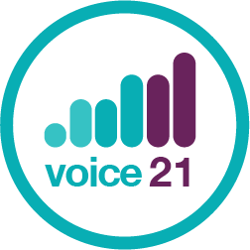
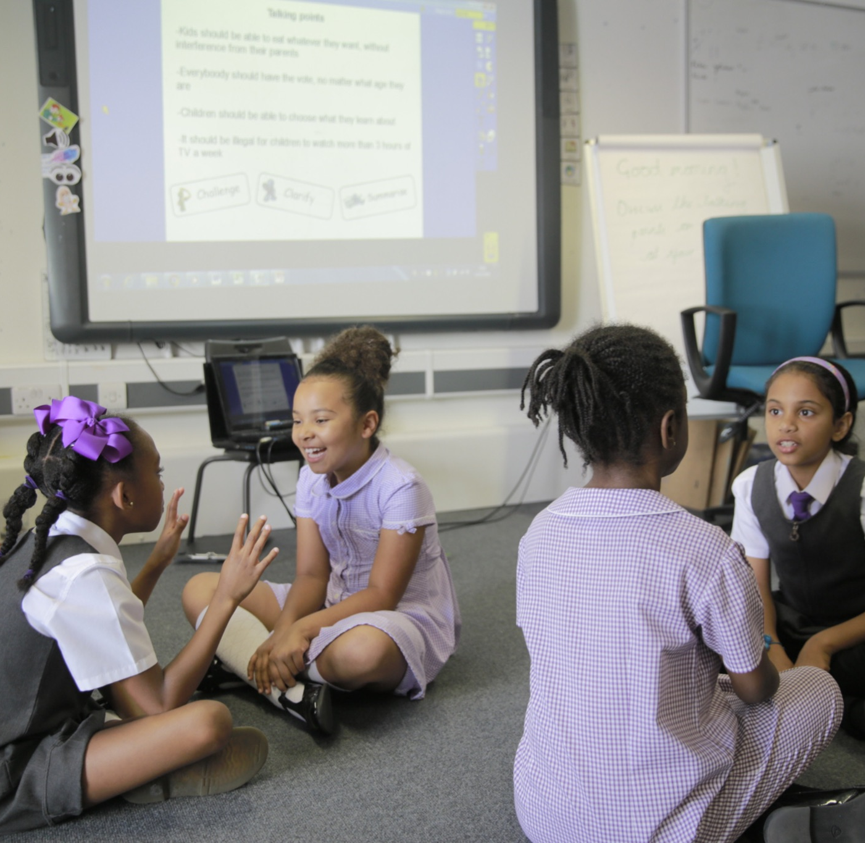
Oracy in Primary Schools
Jo Brumby
Head of Product Management

Slide 2
The case for oracy

Slide 3
Why teach oracy?
Promotes social equity
Narrows gaps
Helps students to thrive in life beyond school
“
“
“
“
“
What makes me enjoy talking the most is that everybody’s listening to you, and you’re part of the world, and you feel respected and important
Overall, studies of oral language interventions consistently show positive impact on learning, including on oral language skills and reading comprehension. On average, pupils who participate in oral language interventions make approximately five months' additional progress over the course of a year.
Essential life skills such as confidence, motivation, resilience and communication are associated with better academic outcomes and bette prospects in the workplace, and there is an increasing emphasis on their value, given labour market trends towards automation
You are the only second chance for some children to have a rich language experience. If these children are not getting it at school, they are not getting it
Young people with poor communication skills are one and a half times more likely to have mental health difficulties, even after taking into account a range of other factors that might have played a part
Fosters wellbeing
Improves academic outcomes
“
“
“
“
“
Increases confidence
Milo, Year 3 Student
EEF Toolkit, Oral Language Interventions
The Sutton Trust, 2017
Professor Neil Mercer
Communications Trust, Talking about a Generation
Notes:
We cannot assume students will “pick up” the oracy skills they need for success in school and life.
We believe that effective oracy increases confidence. Without the ability to communicate and listen to others, children are more likely to experience challenges in the classroom and the playground. By learning to communicate effectively we are supporting them to grow the confidence to manage their interactions, self regulate, integrate, accept and share their ideas. We are supporting them to find their voice.
We also know that oracy improves academic outcomes. Through our own research and working with both schools and academics, we know that “ways of talking shape ways of learning.” Having both the skills and the confidence to articulate ideas and explore and develop understanding can elevate learning.
In a post pandemic world there is an urgent need to foster wellbeing. Unless we give oracy and its connection to wellbeing the recognition and attention it should have in education - we will continue to have young people who are likely to develop speech language and communication difficulties, display challenging behaviours in an effort to be understood and in some cases embark on a trajectory of lifelong mental health and wellbeing challenges. We believe a high quality oracy education can support children to articulate their feelings and engage with the world around them, finding their place as well as their voice.
Of course we also believe that effective oracy skills help students thrive in life beyond school. In an ever changing employment market, it is worth considering that 8/13 top skills involve oracy - the ability to communicate clearly, articulating ideas, collaborating, hypothesising and negotiating should have parity with academic knowledge and understanding.
Lastly we know that oracy narrows gaps/ promotes social equity - Communications trust -talking about a generation - Three quarters of children who experience persistent poverty throughout their early years start school without the language skills they need for learning. With a high quality oracy education, we can provide children with the knowledge, understanding, tools and confidence to bridge those gaps, finding their voice for learning and life.

Slide 4
The oracy gap
Notes:
Theory of Change Animation (vimeo.com)
And unfortunately, research tells us that at the moment, this inequality at the start of a child’s schooling tends to grow/deepen as they move through school.
This is what we want to address as a charitable organisation. We believe that explicit and sustained teaching of speaking and listening skills can make a difference to that gap.
What is the implication of this for fairness in our education system?
The details:
At age 5, 58% of FSM-receiving children are below the expected standard (below ‘working securely on relevant subscales of the Foundation Stage Profile) compared to 37% of non-FSM.
At age 11, 23% (almost 1 in 4) of FSM-receiving children are below the expected reading level (lvl 4 at KS2), compared to 11% of non-FSM.
Bonus info:
Early language is strongly associated with literacy at 11. Children who are below expected language standard at age 5 are over 4 times more likely to be below standard for literacy at 11.
This is likely to be more than just a correlation or some sort of innate ability - the same study shows having poor language skills at 5 is associated with poorer self-confidence and attitudes to learning (which in turn affect literacy levels)
It is also notable that children from advantaged backgrounds are more able to “escape” initial low scores. Analysis for Save the Children (2015 Ready to Read) showed that when you look at the bottom 40% of children by vocab ability at 3yrs, 75% of those from disadvantaged backgrounds are still in the bottom 40% at 5yrs, compared to only 39% of those from advantaged backgrounds. [This obvs speaks more to early years.]

Slide 5
Introducing the Oracy Framework

Slide 6
What is oracy?
A neologism
Literacy
Oracy
Numeracy
Oracy is the ability to articulate ideas, develop understanding and engage with others through spoken language
Notes:
Now that we’ve discussed why oracy is important, let’s consider what we actually mean by the term oracy. The term oracy is not new. It was coined in 1965 by the academic Andrew Wilkinson. It is a neologism: a made up word to give it parity with literacy and numeracy, emphasising the fact that just like literacy and numeracy, it is a skill which can and should be taught rather than simply left to chance. There are many definitions of oracy floating around, some better than others but for Voice 21, oracy is the ability to articulate ideas, develop understanding and engage with others through spoken language.

Slide 7
Learning through and to talk
O
R
A
C
Y
Learning
to talk
Learning through talk
Notes:
In a classroom context, this means learning both to and through talk i.e. providing students with the opportunities to develop their thinking, understanding and subject knowledge through talk but also teaching them the oracy skills they need to talk and do this effectively.

Slide 8
Exploratory vs. presentational talk
Exploratory talk
‘exploratory talk which is typical of the early stages of approaching new ideas […]Exploratory talk is hesitant and incomplete because it enables the speaker to try out ideas, to hear how they sound, to see what others make of them, to arrange information and ideas into different patterns.’
Presentational talk
‘The difference between the two functions of talk is that in presentational talk the speaker’s attention is primarily focused on adjusting the language, content and manner to the needs of an audience, and in exploratory talk the speaker is more concerned with sorting out his or her own thoughts.’
*Barnes, 1992
Notes:
Now introduce the distinction between exploratory and presentational talk: Douglas Barnes, through much research and observation of classroom talk, split the main types of talk found in the classroom into two categories - exploratory and presentational.

Slide 9
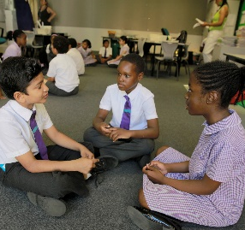
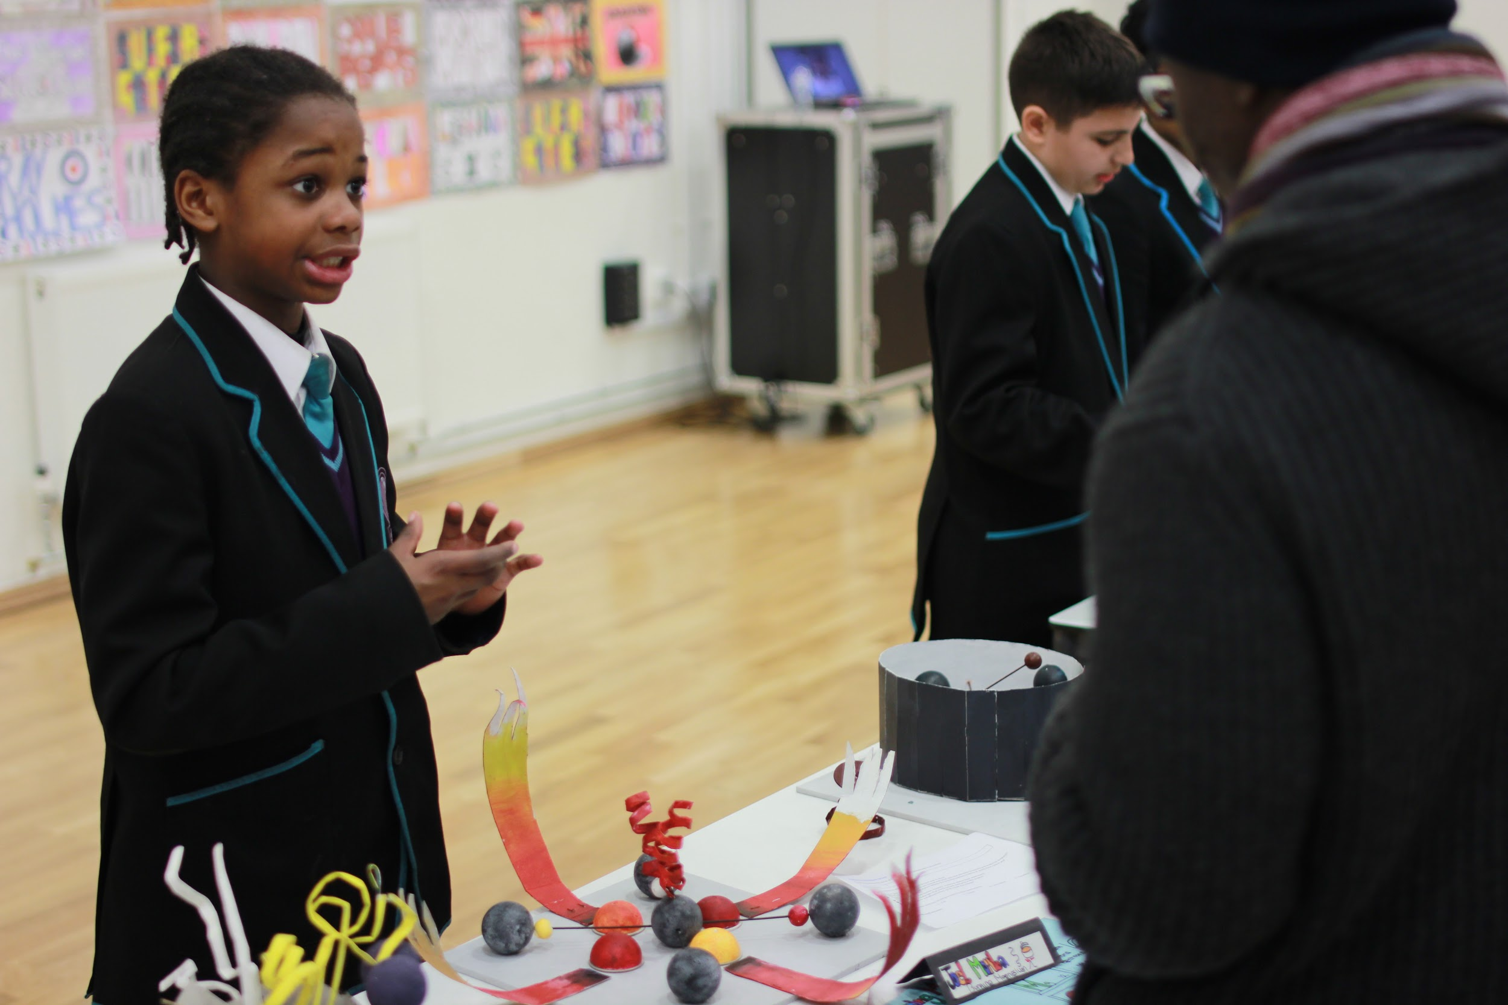
Exploratory vs. presentational talk
Answering a teacher’s question
Summarising a discussion
Debate
Show and tell
Exploratory
talk
Presentational
talk
Notes:
As with most things in education, there will be some examples which are most definitely exploratory or presentational but most will fall somewhere in between, on a continuum.
*Click for examples of types of talk in the classroom and ask participants to signal where on the continuum they think it falls. Use this as a way of drawing out people’s thinking and ideas e.g. ‘Why have you put this as 4?’ - correct any misconceptions, for example, if talk is spontaneous it must be exploratory (it’s actually the audience that matters - presentational talk is talk with an audience in mind).

Slide 10
The Oracy Framework - An introduction
We have divided oracy skills into four categories:
Cognitive
The deliberate application of thought to what you’re saying
Linguistic
Knowing which words and phrases to use, and using them
Physical
Making yourself heard, using your voice and body as an instrument
Social & Emotional
Engaging with the people around you; knowing you have the right to speak
Notes:
Your expectations for talk in the classroom will change depending on whether you are asking students to engage in exploratory or presentational talk. For example, the skills required to have a discussion in English are very different to those required to coach a younger student in PE. The Oracy Framework is an important tool for setting and sharing what your expectations for talk in different contexts. Oracy Framework developed in conjunction with Voice 21 and Cambridge University as part of an EEF pilot project. Introduce each of the strands.

Slide 11
The Oracy Framework
Notes:
Now share the Oracy Framework as a whole- talk through some of the areas. (this will be in their toolkit) Framework. Is there anything that surprised them? Do they have any questions? How might this be useful in their school?

Slide 12
The Oracy Framework - Games
?
?
?
?
Which emotion?
If I ruled the world
1 - 20 game
Articulate
Notes:
Explain that we are now going to play four games. Each game exemplifies one of the four strands. After we have played games, participants will have to explain which game links to which strand.
1-20 works well with the whole room - the rest can be played in smaller groups/ on tables

Slide 13
Using the Oracy Framework
Creating a shared language
Diagnostic and planning tool
Setting success criteria for talk, and providing feedback
Notes:
Also praising specific strands

Slide 14
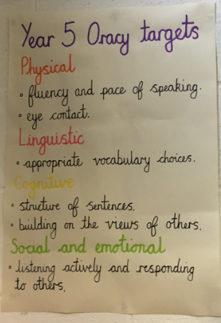
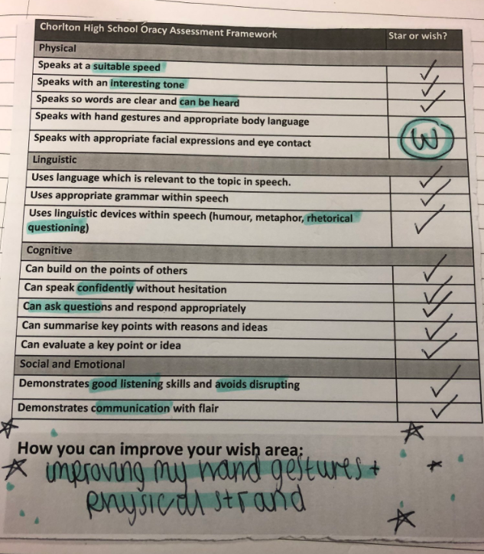
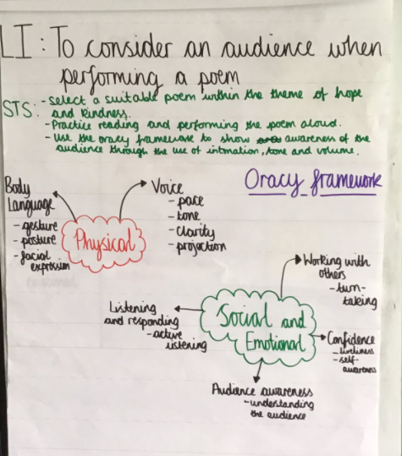
Notes:
Share some different ways that the Framework can be used .e.g adapting and developing as key document in your school (Torriano, top right). Incorporating in your core school values or skill sets (Bishops Young). Using as a tool for reflection and feedback. Creating success criteria using the framework for any oracy task students engage in.

Slide 15
Reflection
Has you understanding of what oracy is changed at all?
Why do you think oracy would be important for your students?
What ideas about the Oracy Framework could you try out with your class?

Slide 16
Email us: hello@voice21.org
Tweet us: @voice21oracy
You can also follow us on Facebook or LinkedIn @ Voice 21
Work with us: www.voice21.org
Notes:
End slide - Please leave as is but always insert it

