Slide 1

What is closing the gap at
Culture and Ethos
Building Relationships
Home-College links
Literacy and Oracy
Behaviour
Pride. Ambition. Community

Slide 2
Building relationships and Home-College links
Building relationships is everyone’s concern:
The College is a place where students feel safe, respected and valued, this is reviewed and evaluated through student voice regularly
There are many opportunities for students to engage in extra-curricular, super-curricular and leadership that actively develop confidence and self-esteem. Where these reflect gender imbalance, intervention takes place to address.
Teachers know their students – transition, pastoral and SEND are important areas of understanding and expertise, proactive steps ensure staff have the information and time to understand individual student needs and profiles.
Peer mentoring programmes support positive behaviours and develop positive role models across year groups
Regular opportunities for student voice, where boys are proactively engaged, with regular public feedback to students to share the outcomes and impact builds trust and confidence
Home-College links ensure consistency and support:
Positive and effective parental engagement strategies positively encourage parental involvement and interest in College life, and the learning and education of their child

Slide 3
Building relationships is everyone’s concern
The College is a place where students feel safe, respected and valued, this is reviewed and evaluated through student voice regularly. Regular opportunities for student voice, where boys are proactively engaged, with regular public feedback to students to share the outcomes and impact builds trust and confidence.
  Student voice that is intentionally representative and includes the “disaffected”.
  Clear actions in response to student voice are communicated on a public cycle.
  Additional staffing and resource into pastoral support, clarity on having some one they know they can trust and talk to.
There are many opportunities for students to engage in extra-curricular, super-curricular and leadership that actively develop confidence and self-esteem.
  Tracked, monitored with overt intervention.
  Overtly linking to “Why” and what they gain by engaging.
  Publicised with celebration of engagement and personal development.
Teachers know their students – transition, pastoral and SEND are important areas of understanding and expertise, proactive steps ensure staff have the information and time to understand individual student needs and profiles.
  Student profiles not just of SEND, directed time with LSAs and Learning Support.
  Closing the Gap meetings with tracked outcomes.
  Staff training on building relationships.
Peer mentoring programmes support positive behaviours and develop positive role models across year groups
  Trained and supported to act in positive and affirming ways for those who need it.

Slide 4
Home-College links ensure consistency and support
Positive and effective parental engagement strategies positively encourage parental involvement and interest in College life, and the learning and education of their child:
  the expectations of each party are clearly set out.
  where support can be accessed is clear
  information about the curriculum, study habits and revision, including what parents can do to help, is clearly accessible
  welcoming and receptive spaces encourage reciprocal relationships and respect parental needs

Slide 5
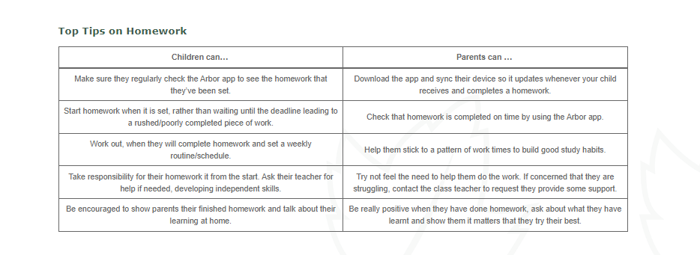
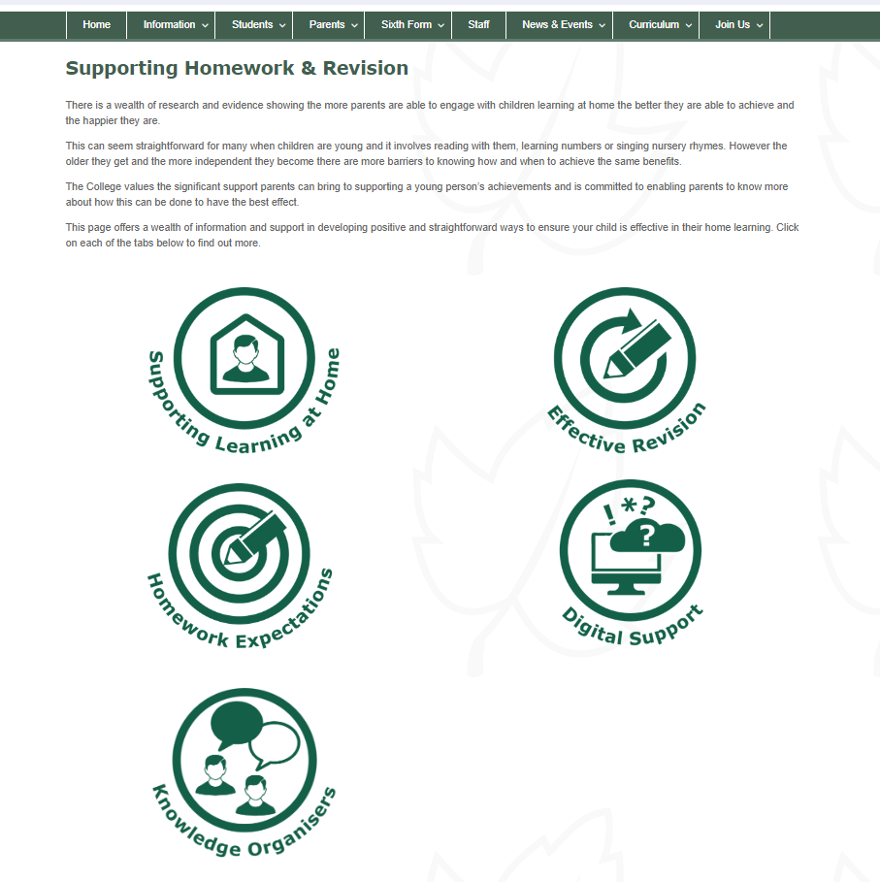
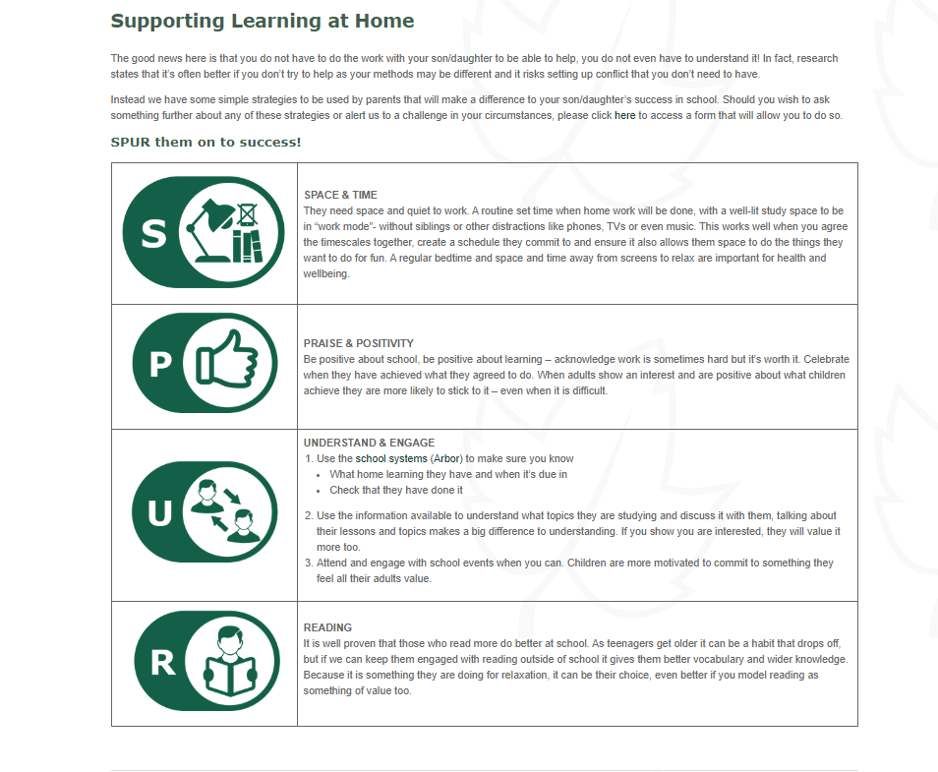
Home-College links ensure consistency and support

Slide 6
Home-College links ensure consistency and support
Positive and effective parental engagement strategies positively encourage parental involvement and interest in College life, and the learning and education of their child:
  a simple, accessible online system for parents to use;
  move to a simple online platform with only one access point.
  jargon-free language:
  all comms through one person to check.
  easy-to-use mechanisms for staff to support positive communication home:
    time given for positive communication.
    training given on building relationships.
    online platform to make it easy and quick to send positive messages.
  frequent feedback loops ensure parental voice is taken into account:
  every parent event, every term, formal and informal.

Slide 7
What is closing the gap at Heathfield?
“Instead of moving as one singular person, we are a community and you feel like you belong somewhere.”
Culture and Ethos
Building Relationships
Home-College links
Literacy and Oracy
Behaviour
“It treats students fairly and equally.”
“Everyone is respected and it’s a nice environment to be in.”

