Slide 1

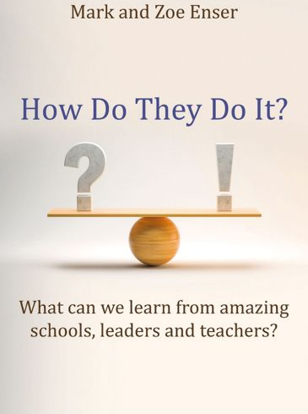
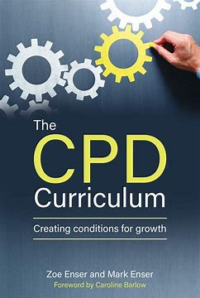
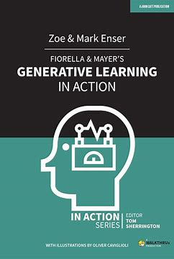

Challenging the Expert
How research can help to support teacher CPD
Zoe Enser
Notes:
Hello all and thank you for Steve for inviting me to come along. I am really pleased to have been invited to speak to you after having been involved with the CC for a number of years.
I’ll just give you a bit of a potted history of me so you can understand a bit about where I am coming from in this talk. I have been working in education since 1997, beginning as a learning support assistant, up to senior leader, with a focus on teaching and learning and CPD. I have then worked across county in school improvement, with the EEF around disadvantage, the Teacher Development Trust and Ambition. I spent two years working in Ofsted as their secondary English and Drama lead, but also was involved in aspects of the ITE and their reviews of Teacher Development. Currently I am school improvement lead in a trust in the North West, which has both mainstream primary and secondary schools as well as Alternative Provision and special. A lot of my focus here is around growing and developing teachers and leaders and as I am sure you can image, there is quite a range of different experiences in those settings. I have also written a few things along the way.
The development of people has always been something central to me. If we can develop the people who are there on the ground working with young people we have got some significant levers in which to make real impact on their lives. Professional development is also something which I feel is central of feeling a sense of value, purpose and motivation when done well.
For me the CC was a really positive step in supporting teachers' development, especially in relation to their engagement with research.
When I first entered the profession, teaching was very much treated as something you sort of caught or didn’t. A bit like how we used to teach reading and writing. Perhaps I was unlucky with what I experienced, but talking to others I know I am not totally alone in feeling that teacher development and how we might use research to enhance that was not at the top of it’s game then.
I’m pleased to say over the years this has improved dramatically, and we now have things such as the CCF and the ECF (which I know can be divisive and still has issues) and NPQs which include an evidence base as a springboard for teachers to explore some of the research available. And of course we have the Chartered College who have an extensive data base as well as courses to support people in different stages of their development.
However, CPD isn’t necessarily a course or an event or something which ends at a certain point in our careers and sometime those whose main goal may be to remain in the classroom as opposed to leadership and to be the best teacher they can be for their pupils. The NPQ suite currently doesn’t do this and there can be a vacuum for this particular group. They can often feel overlooked, express frustration and their lack of agency and perhaps need something a bit different to support their development.

Slide 2
Why Does it Matter?
NFER’s ITT recruitment forecast, based on applications made up to February 2024, suggests that 10 out of 17 secondary subjects are likely to under-recruit in 2024/25.
‘Overall secondary recruitment is forecast to be around 61 per cent of target – an improvement compared to 2023/24. Primary recruitment, however, which is usually at or above its target each year, is forecast to reach only 83 per cent of target next year. ’
Department for Education workforce figures (based on census data from November 2023) are stark. For example, of the 21,705 new teachers who qualified in 2022, 2,453 (11.3 per cent) left after just one year.
Notes:
I am sure I am not telling you anything you don’t know here, but one of the biggest challenges facing our sector is the numbers of teachers both entering and remaining in the sector.
Research by the NFER in March 2024 showed Teacher recruitment and retention crisis shows no signs of abating, new report reveals – NFER. I’ll let you read through those figures and just consider those in terms of your context.
There is often a lot of focus at policy level on how we attract people to the profession as well as support them in their early careers. There are plenty of glossy adverts to get people to see teaching as attractive and there will always be a natural attrition when we have a climate where other career options are available which might be more flexible or if we indeed have an aging workforce.
However, we must not overlook institutional knowledge. This is something which often sits with more experienced colleagues. This is is essential in supporting those new to the profession, not only through direct mentoring but in providing a stable environment in which that learning can take place. Even if the government were to recruit the numbers needed to sustain the workforce there would be a deficit within the profession in being able to ensure those new entrants are likely to remain.
Hot off the press yesterday, you may have seen that the government has published their targets for recruitment by almost 20% as recruitment has risen across most subjects. This is also coupled with falling pupil numbers and an increase in retention. This sounds like a really positive shift but there is still work to do. English and classics did not accept more applicants and there are other areas where we know recruitment is tricky, for example in DT or in Alternative Provisions and specialist settings. There are also regional variations and something which has come into sharp focus for me both when working in southern coastal schools and now again when I am working in the North East.
Tt is even more important we consider how we can develop people in a way which encourages them to want to stay, if not with us directly, but within the profession.

Slide 3
Addressing the Issue
‘Research has shown that, where professional development is effective, teachers feel that their training and development across a year has allowed for focused, sustained and iterative changes to clearly defined key areas.’
Independent review of teachers’ professional development in schools: phase 2 findings - GOV.UK (2024)
Notes:
As I said earlier professional development is a key aspect of this for me.
This is a quote from the Independent review of teachers’ professional development in schools: phase 2 findings - GOV.UK (2024). Just take a moment to reflect on that.
From my perspective I found that engaging with two things was essential in wanting to remain in teaching for the 20 years that I did. That was engagement with my subject, a key aspect which can sometimes be overlooked, and educational research.
It is also what has kept me wanting to engage with the sector and work with schools despite not being in the classroom.
However, we know many people, myself included, spent a significant amount of time in CPD session which felt like they were just a waste of time. Often it felt either irrelevant or patronising.
This in turn can lead to CPD being dismissed as ineffective or unnecessary (obviously you would disagree as you are here today, but I imagine this will have been something you have encountered).
But research into professional development shows it can actually help people to feel a greater sense of purpose, feel professionally challenged and have benefits in terms of workload and job satisfaction.

Slide 4
Srivastava and Gupta, 2025
‘a positive correlation between professional development and job satisfaction, with teachers who have access to meaningful and supportive opportunities reporting higher levels of satisfaction.’
Notes:
In 2025 Srivastave and Gupta found there was ‘a positive correlation between professional development and job satisfaction, with teachers who have access to meaningful and supportive opportunities reporting higher levels of satisfaction.’
The Relationship between Professional Development and Job Satisfaction among Secondary School Teachers | Journal of Informatics Education and Research
Teachers who are satisfied in their role and aligned with our goals of improving outcomes for all, are going to be more likely to be retained. Professional development linking to outcomes was an factor highlight by Cordingly et al in their 2015 paper DGT Full report (1).pdf, and is obviously the goal for us all. But is also a real challenge within the landscape we are working within.

Slide 5
Motivation
‘teachers are tasked with restructuring the minds of thirty unique children at once, some of whom don’t want to be there’
Developing expert teaching: Peps Mccrea
Notes:
So, what are some of the key things we need to consider when we are designing effective CPD and where do expects fit in?
We need to consider motivation. What is going to drive the change we want to see? click
And I ask you, how different is this really to the role of those of us who are delivering CPD?
We may know our audience and their strengths and knowledge and their gaps really well.
Equally, we may not or be working from a misconception about their knowledge and experience, especially when we are dealing with expects.
But motivation in learning matters and we need to consider how we can best do this, especially if we are talking about changing or adapting practices which they may have been developing already for years.
If we haven’t built the right conditions for that to happen, developed the relational trust in our staff where they know our actions will have a positive impact and they don’t know why this particular aspect of development or change is something they want to buy into, they are likely to want out.
You may be lucky and already have a captive audience, but even with the keenest learners amongst us, there will be some who are not quite in the right place for the learning to happen, and CPD doesn’t always happen at the right place and at the right time for all. End of days after 5 period lessons might not be the best place. Woven through the school day and the conversations you are having across the piste might be better. Placement of when professional development happens needs to be carefully considered as well as what we are going to be working on and why.
A further point Peps’ makes here is about restructuring the mind, or the schema, and I think this is an important one in professional development too. Here we are restructuring some well-developed schema, with perhaps many years experience of teaching, in a way they may have developed themselves over time, well before we turn up bright eyed and bushy tailed with our power points and new ideas.
So we need to think about how we can harness that expertise to want to come along with us.

Slide 6
What do teacher learners look like?
(1) novice;
(2) advanced beginner;
(3) competent teacher;
(4) proficient teacher;
(5) expert teacher.
(PDF) The Development of Expertise in Pedagogy, David Berliner, 1988
Notes:
This is where David Berliner comes in for my considerations of professional develop. We need to really think about what our learners look like. And as I intimated before, I do think it is important to consider our teachers in terms of learners. Just like our pupils they will have different starting points and even greater differences in what they know and can do than perhaps an average Year 9 class who are having a brand-new concept introduced to them. This needs to be recognised when we are designing our programmes and thinking about how best to go about thing.
The longer someone is learning about or working in a particular area, the greater their knowledge base is and David Berliner categorised these in this way. It sounds wonderfully linear, but of course it is not. Nothing is ever that simple and there are no tick lists. You may have real expertise in how you are checking for understanding but perhaps are less familiar with things like hinge questions and how we might ensure high rates of success using different formative assessment approaches. It is a continuum whereby any of us may return to different stages at different points, but there are still some important considerations about what the key differences are between those who have been teaching for a considerable period of time and those who have not.

Slide 7
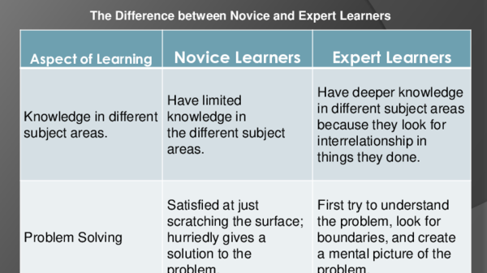
Notes:
Here’s another way of thinking about it.
The novice/ expert divide is often seen as being quite disparaging of the novice. However, when we consider this with pupils and their development we know that they have a more limited base of knowledge to draw upon and are likely to rush to poorer solutions to problems, often emulating what is seen. This is just part of the process and why we have things like mentoring to support those new into the profession. They are there to provide additional knowledge and scaffolds when it comes to the problem solving, filling in gaps as needed.
What experts need is a bit different and this, is what I want to explore.

Slide 8

Have deeper knowledge in different subject areas
The curse of the expert
Habits are hard to break
Notes:
I want to unpick this statement about exerts a bit because although this is a hugely important, it can also be a bit of a stumbling block to teacher development and something which is not always explored in depth.
While it is true they have a deeper knowledge and make connections between different areas, what experts can find difficult is seeing beyond it. Sometimes we refer to this as the curse of the expert, whereby either that knowledge is so deep and connected it can be difficult for them to actually see it in isolation, it has become tacit, or it can be hard to move beyond it. Equally, it might lead to ‘gut instinct’ responses, which are actually built on a lot of tacti knowledge, but there are no guarantees this instinct is right.
Equally, while experts have a huge amount to bring to the party, those well-developed schemas or metal models, can be quite rigid. Just as when we want to try to change a habit around exercise or diet, it can be difficult to change something which has become automated. I found the work of Mike Hobbiss, Sam Sims and Becky Allen around this particularly interesting. When we have well-established habits built on experience, it can be really challenging to make a change. Couple this with a schema of knowledge telling we have something of a perfect storm for things going wrong.
We also need to consider the problem-solving aspect identified and what this means for us.

Slide 9

Try to understand the problem
You have been teaching in a setting for 15 years. One lunch time a senior leader comes up and tells you:
‘we have decided to put all desks in rows. You need to move yours later today’
How would you react?
Notes:
Experts have the knowledge and experience to problem-solve. However, they need to understand the problem beyond just the superficial in order to engage with this.
This is something I often found to be lacking in some professional development and a barrier for the development of more expert teachers.
Leaders have often identified the problem, sometimes in isolation or only with a small group, and spent limited time of actually helping the expert to understand what the issues is. Sometimes explanations are limited to surface features or instructions. It is understandable that the expert may then feel the urge to resist, go in a different direction, especially if they are experiencing something different in their classroom, or feel frustrated that their voice has not been heard, and their knowledge of the problem is not valued.
So thinking about our experts with their well-developed and connected schemas about teaching and subject and their problem solving skills, how can research help us?
Click
Consider this rather simplistic example:
You have been teaching in a setting for 15 years. One lunch time a senior leader comes up and says ‘we have decided to put all desks in rows, you need to move yours.’
How would you react?
It sounds like a little thing, but from a expert's point of view there has been no explanation of the problem (attention, behaviour across the school, reduction of extraneous cognitive load with a range of different room layouts), no opportunity for them to understand that this is something impacting on colleagues and no opportunity to input.
Now many of you will have inferred the reasons and some of you will have just done it as you trust what your leaders are saying, but we are missing a trick with our experts when we don’t help them to understand the problem. As with habits, understanding the why and helping to be part of the solution is something that will help experts to thrive. That is not to say those desks don’t get moved, but they get moved with a renewed focus on attention, expectations, optimising cognitive load as well as someone who will help to reinforce the messages, using their experience to support colleagues, and will feel more aligned with the purpose of what you want to achieve.
As I said, this is a simplistic example, but if we scale that up to other areas like development of subject pedagogy in relation to retrieval or use of modelling or different approaches to supporting pupils with SEND, then you can see how this could make a difference.

Slide 10
How can research help
Disrupting the schema and changing habits
Providing a deeper understanding of the why
Improved sense of purpose and motivation
Providing greater levels of efficacy and problem solving
Reduce workload
Build knowledge to support others
Notes:
Firstly, research can be a powerful lever for it disrupting the schema of the expert. I’m not talking about disrespecting that deep knowledge they hold but about providing ways to see things differently. A different lens.
Those well-developed schema are useful but we need to be cautious in assuming they hold the same information as us or the right information. Some of knowledge may have been acquired partially and some may indeed be false- think of how many people still cling on to the idea of learning styles. That is not just teachers but the general public and a video from Dan Willingham a few years ago really showed us how deep seated that belief is.
The expert schema may also contain a lot of noise, sometimes meaning that issues may not be seen clearly. Introducing research to the conversation can provide something that is both concrete and abstract, depersonalised so we step away from our immediate thinking and have a chance to explore things from a different angle. Research can help us to cut through the noise of what we have experienced and challenging our thinking.
Research can help experts to consider their existing mental model differently and examine why something has or has not worked. Which leads them to an understanding of why leaders or others might want to solve this particular problem in this particular setting.
Click
Using research will also help experts to have a greater understanding of the problem and the why we do things that we do. It will support them to unpick their own mental models and habits and make changes. We are also more likely to get buy-in with that understanding and people who are going to help us to understand the problem further.
For those leading CPD providing prompts, direction and opportunities to discuss findings, both from reading and from their own exploration in their classrooms, will help to guide the expert teacher but also provide opportunities for mutual learning.
Click
Research can also motivate, as people are challenged in their thinking and engage in those problem-solving exercises. It can also help to realign us with our core purpose, where we focus sharply on what we can do in our classroom to make a difference for young people. This sense of efficacy can in turn help our motivation and bring us back to a problem-solving approach .
Click
And believe it or not research can help with workload. Exploring what is and is not effective practice can help us to make positive changes. If we think for example about the marking and feedback research which has helped to highlight that not every piece of work requires deep and complex marking and live feedback and marking can have the same, if not more, impact on learners, you will see what I mean. Equally, research that helps us to know why something works can lead us to make sharper decisions and short cut to what works.
Click
And finally, we know our experts are often our leaders, our role models and those who we want to help to support those new to the profession. As I said at the start, their institutional knowledge is key. They will often be formal or informal mentors to new staff. They can be our strongest advocates in developing new structures and approaches and helping them to take a lead with research will support that.

Slide 11
How to do it
. Remember the expert
1
Use research to support the why
2
Use research to prompt curiosity
3
Use research about learners to design your approach.
4
Notes:
So I think I have made a clear case as to why we want to embrace our experts when we are thinking about professional development. The most difficult aspect those with CPD, much like with implementing anything, is how to make it happen.
These are my key tips when thinking about PD. Obviously I am going to recommend a clear curriculum for CPD as I think a programme which has been carefully considered in terms of content, sequence and delivery is something all learners deserve.
Click
But when we are designing that we need to remember the expert.
Perhaps too often, we consider the steps and stages of the novice when we are thinking about CPD. We often start from a position of the group before us knowing little about the topic at hand, as opposed to embracing them in terms of finding out more about what is happening and why.
While our CPD curriculum will need to cater for people at both ends of the continuum, that does not mean less for those who are expert. But it does mean something a bit different. While with a novice you might be using a coaching approach (instructional coaching) where we heavily scaffolding their first attempts or reflections, with experts you still need to be able to revisit concepts and practices with them and continue to probe and challenge.
Kim Scott of Radical Candour fame, in her last book Radical Respect, she talks about all having an entitlement to feedback. This challenge and probing which will disrupt or restructure thinking, and potentially push to change, is, she says, a kindness of which we are all deserving. If we don’t give challenge or feedback then we are short-changing our experts, even if the messages they are giving us is that they want to largely be left alone to do their thing in the classroom.
Our programme needs to be rooted in research to help to explain and frame the why we are doing things, why we want to explore this area and the problem it is trying to solve. Feed this in sooner to your experts rather than later. Give them something challenging to read and think about, not only the summaries you might use elsewhere. We know in Education we have very few absolutes, but we do have something often termed, best bets, and get your experts to start exploring them and find out more about why they might work and identify the pit falls.
Although teaching is a challenging and time-consuming job, we do want to find out more about what works and why and I am yet to meet a teacher who isn’t keen to try to do it even better. Ultimately if we teach something really well and pupils understand it and can do something as a result, that is a huge workload saver too. Introducing aspects of research to think about how we can make learning more effective, build what we want to see in our pupils and save us all time. But if someone has a particular direction they want to go in, embrace that too. We might not be able to do that whole sale, but give people the space to go in a direction that research is taking them and build in time to explore that with them.
And keep in mind that we are all learners. Take what we know about learning for pupils and consider it’s implications for adults. What do we know about cognitive load, clear explanation, thinking time, and small steps and sequences of learning. All of this is still relevant to experts but it might look a bit different.

Slide 12
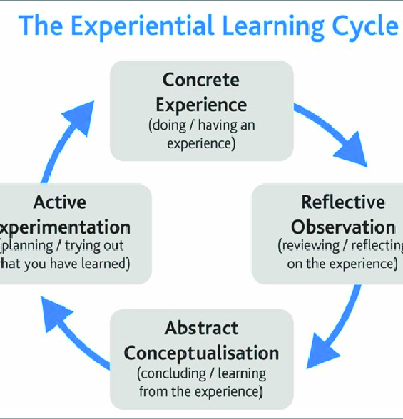
David Kolb, 1988
Notes:
I personally am a fan of David Kolb’s experiential learning cycle as a way of thinking about Teacher Development, especially with experts. I wrote about my experience of this in an impact article a few years ago and I also use it in the CPD curriculum.
This is a model you will have seen in action with Dylan Wiliam’s TLC groups from Embedding Formative Assessment. It is also an iterative process used in NPQs, referenced by the EEF and a range of other groups who provide CPD.
Expert teachers arrive with a significant amount of concrete experience, which I want them to think deeply about. There are different ways you can do this, including via visiting the lessons of others or different settings, but research will support them thinking about their classrooms whilst layering on some new information.
Reflective observation is about being aware in the moment, disrupting those habits if needed or refining what is happening. There needs to be some time for that reflection and self or further observation of what it might look like, Then you come back to the abstract, thinking again outside of the concrete experience and returning the research can help here too. What was it actually like when you tried it in relation to what the research said? Why?
And finally taking the idea and Actively experimenting with it, within the boundaries of subject and the research. Small steps and changes which can then feed into further concrete experience.
This is what I found useful in my own and others’ development but there are other models.
However, for the expert in particular the adjustments about the timings of these different elements, the types of research and how the active experimentation can make a huge difference. This cycle can happened quickly or slowly over time.
The cycle provides an opportunity to understand the why, problem solve, reflect, disrupt the schema, and have the space, the agency, to explore it in practice, before coming back to reflect some more.

Slide 13

Autonomy verses Agency
There needs to be a framework
People don’t thrive when micromanaged, especially experts.
Action research, problem solving and lots and lots of dialogue.
Research can take us beyond our settings and challenge us. Make use of the challenge to give experts agency to explore what may or may not work.
Notes:
I want to just finish by talking briefly about autonomy verses agency.
There is a lot of discussion in teaching about issues with autonomy, especially for experts. Some people have suggested that lack of autonomy is a key factor in retention, and I don’t think we can ignore that. Being micromanaged is never a useful tool for leadership, especially when those being micromanaged are the same people, we are relying on to enact a range of different things in our absence and make lots of key decisions in the moment. We don’t want to disempower them to do this. To come back to David Berliner’s points about expert and novice, there is a deep and connected understanding we want to tap in to and an ability to problem-solve which we want to share.
However, total autonomy is certainly not desirable for a novice, who may well be overwhelmed by the decisions they need to make and perhaps reach some wrong conclusions. Even those who have taught for a number of years may not have reached a high level of expertise. There is more to this than just time in the classroom. I think it is Eistein who is often, possibly misquoted, as saying the definition of madness if doing the same thing over again. We all have much to learn and none of us have it all sussed. As I have said, expects too need scaffolds to disrupt their schema and habits, especially if we are looking for change.
click
All of us also have to work within certain frameworks which are statuary, such as the national curriculum. Very few of us do actually have real autonomy within the workplace and perhaps those wishing for it may not have a full understanding of why we might have the limitations we do.
However, that is not to say we should not consider different levels of agency within that.
There needs to be space to respect the experiences of those in the classroom. There needs to be space for the integrity of the discipline or phase/ setting to shine through.
Coming back to motivation, we know from the work of people such as Daniel Pink in Drive, that having the opportunity to explore within those petametres and a belief you have the efficacy to make positive change really matters.
Click
Things like action research, at varying levels, leading the learning of other professional to support them to problem solve, and lots and lots of dialogue centred around what the key issues which we are facing within our contexts, are helpful in ensuring that people get a sense of agency. The Kolb’s cycle has this space for reflection and experimentation built in and can be a good way to allow people to make a range of decisions within the guidelines you have established.
Click
And using research to think outside of the immediacy of resources, behaviour, duties, can feel like a luxury but also offer that robust professional challenge we can thrive on.

Slide 14
References
Scaffolding by novice and expert teachers: The difference BERLINER, D. C. (1986). In Pursuit of the Expert Pedagogue. Educational Researcher, 15(7), 5-13. https://doi.org/10.3102/0013189X015007007 (Original work published 1986)
Teachers’ analyses of educational research as a source of professional development Perspective Article David C Berliner Published on: September 14, 2020
Developing great teaching: lessons from the internation reviews into effective professional development, Cordingly et al, 2015, DGT Full report (1).pdf,
Independent review of teachers’ professional development in schools: phase 2 findings - GOV.UK (2024)
Microsoft Word - Habit formation limits teacher effectiveness_revised.docx, Hobbiss, Sims and Allen, 2020
(PDF) Experiential Learning: Experience As The Source Of Learning And Development, David Kolb, 1984
NFER in March 2024 Teacher recruitment and retention crisis shows no signs of abating, new report reveals – NFER
Developing expert teaching, Peps Mccrea, 2023
The Relationship between Professional Development and Job Satisfaction among Secondary School Teachers | Journal of Informatics Education and Research V Srivastava and Satyendra Gupta, 2025
Notes:
I have included most of my references here, but know I also reference Dylan Wiliam and Dan Willingham, who I am sure you are familiar with. I would also strongly recommend looking at the EEF materials around designing effective professional development as well as making sure that subject and phase are given time and space to develop in line with your priorities too.
I’d also like to return to a point I made earlier which was about the two things that kept me in teaching for 20 years and continues to keep me wanting to engage with schools and that was research, but also subject. We really do need to ensure that with whatever we are developing, the subject, the phase or the setting is front and centre. While there are commonalities we need to ensure that the research we are using is relevant for the age group, the subject or the needs of our learners. It can easy to think one size fits all, and experts in particular, will be quick to point out that really is not the case.
Finally, I would just like to say my next book, written in collaboration with Mark Enser, who I am sure you won’t be familiar with, is due to be released in the coming weeks, if I am to believe Crownhouse, and it is called How to they do it? And is a amalgam of what great schools and leaders do and includes more about professional development and the role it plays in making sure schools are as great as they can be.
Thank you again Steve for inviting me. I am happy to take any questions people might have.

Slide 15
@greeborunner bringingforththebard@gmail.com

